Slide 1
Name: Manisha Gowda
Roll No:30
BBA/Sem-6
Disaster Management

Slide 2
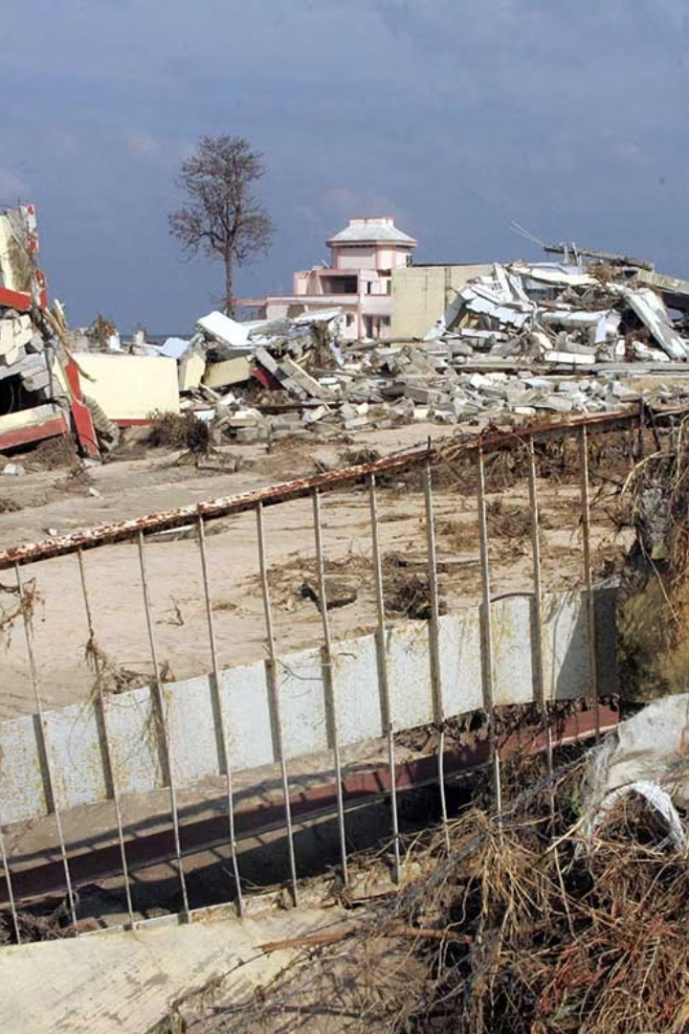
Introduction to Tsunami in Andaman and Nicobar Islands
The Andaman and Nicobar Islands are a group of islands in the Indian Ocean, located between the Bay of Bengal and the Andaman Sea. One of the significant challenges faced by the Andaman and Nicobar Islands is the threat of tsunamis. These islands are situated in a seismically active region prone to earthquakes, which can trigger tsunamis.
In 2004, Andaman and Nicobar Islands were hit by a devastating tsunami caused by a 9.1 magnitude earthquake. The colossal natural disaster had a profound impact on the region.

Slide 3
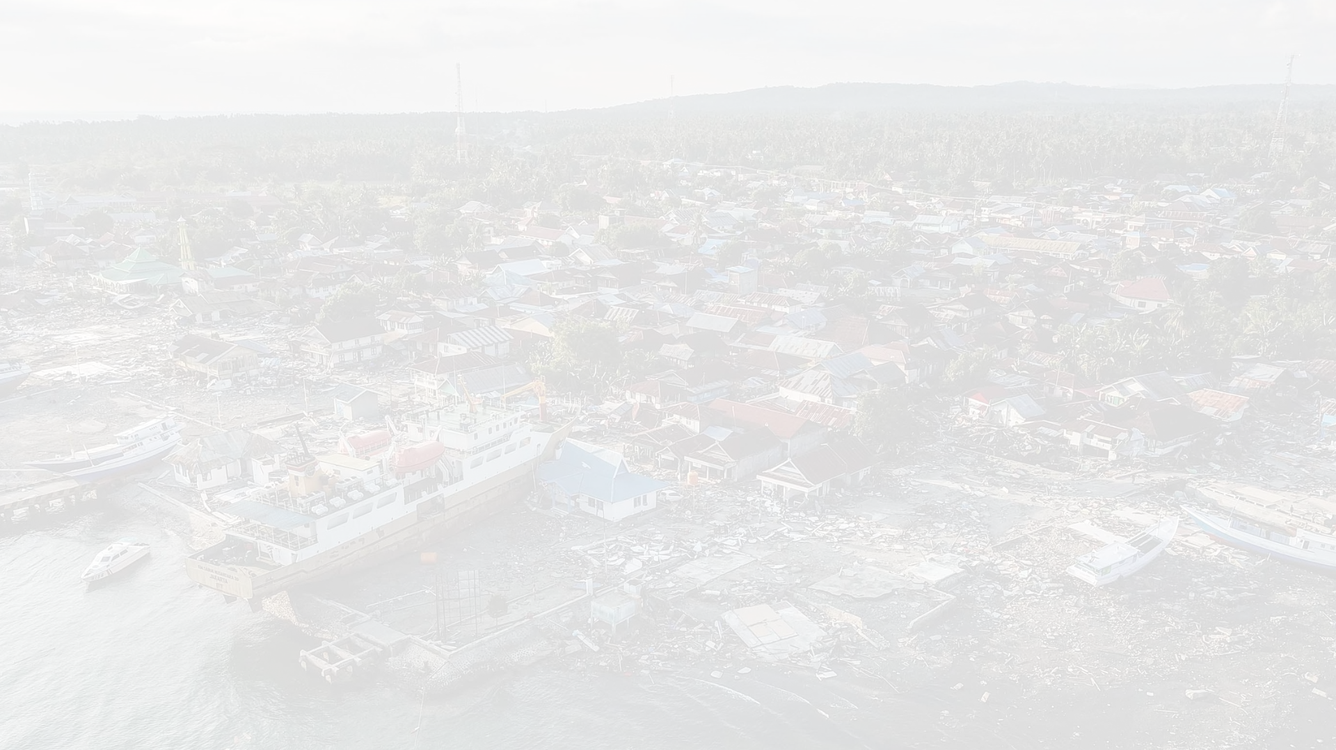
Causes and Effects of the Tsunami
1
Undersea Earthquake
An undersea earthquake, also known as a seismic event beneath the ocean, is the primary cause of a tsunami. The sudden movement of tectonic plates creates a powerful disturbance in the water, resulting in massive oceanic waves.
2
Destructive Impact
The tsunami's destructive impact on coastal areas is devastating. As the powerful waves strike the shore, they cause widespread destruction, leading to the loss of life and significant damage to infrastructure such as buildings, roads, and bridges.
3
Environmental Aftermath
The aftermath of a tsunami has significant environmental consequences. The sudden influx of large amounts of water disrupts the ecological balance, impacting marine life and the aquatic ecosystem. It can lead to the destruction of coral reefs, damage to coastal habitats, and changes in water quality.

Slide 4
Areas Affected
Some areas of the Andaman and Nicobar Islands that are particularly vulnerable to tsunamis include: 1. Coastal regions: Low-lying coastal areas are at higher risk as tsunamis can inundate these areas with water, causing widespread damage. 2. Islands closer to tectonic plate boundaries: Islands situated closer to tectonic plate boundaries, where earthquakes are more frequent, are more vulnerable to tsunamis. 3. Uninhabited islands: While all areas of the Andaman and Nicobar Islands are susceptible to tsunamis, uninhabited islands may not have adequate warning systems or infrastructure to mitigate the impact. 4.Port Blair: As the capital city and one of the most populated areas in the islands, Port Blair is also at risk of tsunamis due to its coastal location.

Slide 5
Evacuation Plans and Procedures
Early Warning Systems
Establishment of sirens and broadcasting systems for prompt alerts.
Evacuation Drills
Practicing mock drills to ensure preparedness and swift evacuation.
Community Education
Education programs to instill awareness and readiness at the grassroots level.

Slide 6
Government Initiatives for Tsunami
Reconstruction Efforts
Policy Formulation
Community Support
Government allocated funds for rebuilding settlements and infrastructure post-tsunami.
Regulations were implemented for coastal construction and disaster management.
Setup of relief camps and distribution of food, water, and medical aid.

Slide 7
Early Warning System
The Andaman and Nicobar Islands have an early warning system for tsunamis. This system works by detecting earthquakes in the ocean. When a powerful earthquake happens, sensors pick up the movement and send signals to alert centers. These centers then issue warnings to the islands, giving people time to evacuate to higher ground and stay safe from the tsunami waves.

Slide 8
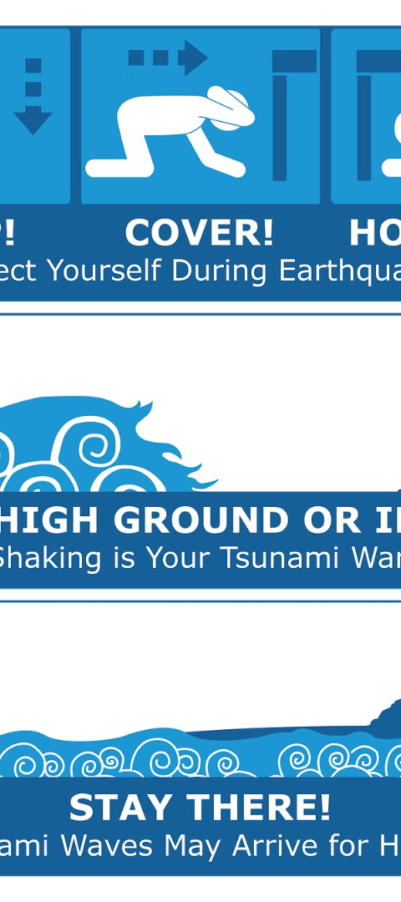



Future Preparedness Measures
Enhanced Technology
Continued advancement in early warning systems and disaster-relief technologies.
Community Training
Empowering local communities with comprehensive disaster response training.
Strategic Infrastructure
Developing resilient coastal infrastructure to mitigate tsunami impact.

Slide 9
Conclusion
In summary, tsunamis have had a big effect on the Andaman and Nicobar Islands, showing why it's important to be ready for disasters, have early warning systems, and strong buildings to reduce damage in the future. We've learned a lot from past tsunamis, leading to better plans for managing disasters. This includes teaching people, making evacuation plans, and working together with authorities. But we still need to keep watch and spend money on making sure the islands and the people who live there are safe from tsunamis.

